Slide 1



Domestic Abuse

Slide 2
What is Domestic Abuse?
Definition of domestic abuse
Behaviour of a person(A) towards another person(B) is “domestic abuse” if:
- A and B are each aged 16 or over and are “personally connected” to each other
- the behaviour is abusive
Behaviour is “abusive” if it consists of any of the following:
- physical or sexual abuse
- violent or threatening behaviour
- controlling or coercive behaviour
- economic abuse
- psychological, emotional, or other abuse
And it does not matter whether the behaviour consists of a single incident or a course of conduct.
Notes:
This is the legal definition of domestic abuse from the Domestic Abuse Act 2021. The aim was to create a statutory definition of domestic abuse, emphasising that domestic abuse is not just physical violence, but can also be emotional, controlling or coercive, and economic abuse.
Resources
Legislation: Domestic Abuse Act 2021 (legislation.gov.uk)
Statutory Guidance: Domestic Abuse Act 2021 - GOV.UK (www.gov.uk)

Slide 3
Types of Domestic Abuse
Intimate partner abuse
Teenage Relationship Abuse
Abuse by Family Members
Child to Parent Abuse
Harassment or Stalking
Religious Abuse
Verbal Abuse
So-called “Honor” Based Abuse
Female Genital Mutilation
Notes:
More information in Domestic abuse guidance - Chapter 2 understanding domestic abuse https://assets.publishing.service.gov.uk/media/62c6df068fa8f54e855dfe31/Domestic_Abuse_Act_2021_Statutory_Guidance.pdf
For those working with children & young people it should be noted that a child is someone under 18, but the domestic abuse legislation applies to people over the age of 16, this means that teenage relationships for those over 16 should be considered within the context of safeguarding children as well as domestic abuse, likewise for children who may abuse their parents.

Slide 4
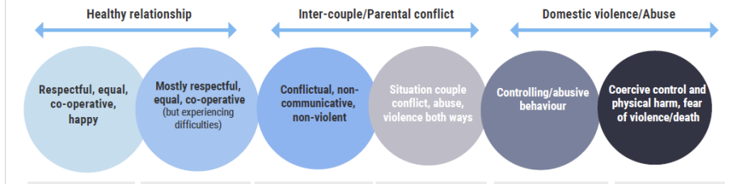
Understanding Dynamics & Professional Curiosity
Explore Dynamics:
Assume Nothing
Believe the unbelievable
Challenge your own thinking
Notes:
The continuum above is designed to help people explore the dynamics of a relationship; constructive conflict is a natural part of any relationship & would exist in respectful, equal & co-operative happy relationships and people feel easily able to voice their views and opinions that may differ from those of others, but they are still given respect.
Frequent Intense and poorly resolved disagreements can be assign of difficulties emerging.
Conflict that is not resolved and leads to non-communicative but non-violent responses can be destructive and has a negative impact on all involved including children.
Situation couple conflict, abuse and violence where there is not coercion or control can also be harmful to all involved, including children, and care needs to be taken to thoroughly explore any possibility of control within a relationship, as this raises concerns of risk and harm. Someone may never be physically abusive another but still control them. It is also not unusual for someone being controlled to hit out in frustration, so they could be viewed as a perpetrator of abuse when in fact their retaliation is a result of abuse perpetrated against them.
Exploring dynamics requires the tenacity to not assume the first thing presented is what is really happening, to have the ability to be professional curios, question what is presented, seek information from several sources and always be aware that anything is possible; to assume nothing, believe the unbelievable and challenge your own thinking.
More information on professional curiosity; https://www.safeguardingsolihull.org.uk/wp-content/uploads/2022/12/Professional-Curiosity.pdf

Slide 5
Recognising Behaviours of Domestic Abuse
Coercive Control
A pattern of intimidation, degradation, isolation and control with the use or threat of physical and sexual violence
- Unreasonable demands
- Isolation
- Disability/ exhaustion
- Degradation
- Restricting daily activities
- Enforcing trivial demands
- Threats or intimidation
- Financial control
- Monitoring of time
- Taking your phone away
- Deprivation of food
- Destruction of possessions
- Occasional indulgencies
- Displays of total power
Physical Abuse
Emotional Abuse
Financial Abuse
Psychological Abuse
Sexual Abuse
Digital Abuse
Notes:
Domestic abuse is not just physical violence, in fact sometimes it does not always include physical violence, and the continuum on the slide before identifies that the higher risk and likelihood of harm are when coercive and controlling behaviours are present.
Many people consider domestic abuse incidents, which often relate to when there has been physical violence; this view needs to be challenged, as people living in domestic abusive relationships do not stop suffering between these ‘incidents’ people will suffer many other types of abuse outlined in this slide and coercion and control means consistently having time and movement controlled, being imprisoned as they don’t have freedom and deprived of resources and isolated from the outside world, even when they are functioning within it; this includes children in the household.
Resources
Chapter 3 statutory guidance: https://assets.publishing.service.gov.uk/media/62c6df068fa8f54e855dfe31/Domestic_Abuse_Act_2021_Statutory_Guidance.pdf
Power and Control Wheel | The National Domestic Violence Hotline (thehotline.org)
Further information on the impact of coercion & control on Children available at https://avaproject.org.uk/wp-content/uploads/2016/03/Emma-Katz-2016.pdf
Further information about coercion and control https://www.safeguardingsolihull.org.uk/wp-content/uploads/2023/09/Coercive-Control.pdf

Slide 6
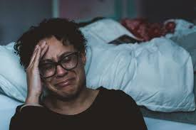
Impact of Domestic Abuse to the Victim
Survivors are likely to be impacted in a range of ways from experiencing domestic abuse:
Mental Health
Experiencing domestic abuse can impact mental health in a variety of ways, with reported higher levels of depression, anxiety, stress disorders (such as PTSD), eating disorders, low self-esteem, self-harm, and suicidal thoughts or attempts.
Emotional
Living through domestic abuse can make it difficult to function in daily life. Victims may feel ashamed, see themselves as unworthy, and suffer from a significantly diminished self-perception.
Physical Health
In the short term, survivors may experience injuries such as bruising, lacerations, burns, cuts and broken bones. More serious injuries may lead to disabilities.
Social
Victims may be isolated from family and friends through both coercive control, and by choice. Victims may also be isolated from the community or work for the same reasons.
Financial
Leaving an abusive relationship can have financial implications, such as costs for housing, transportation, and legal proceedings. Financial abuse can also lead to poverty for victims. Victims may also lose their job due to absences or being forced to.
Limited ‘space for action’ –
that is they do not have freedom to say and do things and to meet their own needs without worry or fear
Notes:
Further information on the impacts of coercion and control on mothers and their children can be found at https://avaproject.org.uk/wp-content/uploads/2016/03/Emma-Katz-2016.pdf

Slide 7
Impact of Domestic Abuse on Children
Constraints on their freedom
Control of their time and movement
Isolation from wider family, peers and extra-curricular activities
Restricted social lives
Reduced opportunities for fun and affection
Damage to parent child relationships
Neglect
Emotional abuse
Physical abuse
Sexual abuse
Section 3 of the Domestic Abuse Act 2021 recognises children as victims of domestic abuse if the child sees, hears, or experiences the effects of the abuse, and is related to, or falls under “parental responsibility” of, the victim and/or perpetrator of the domestic abuse.
Notes:
Children are noe recognised victims of domestic abuse- Living in a home where domestic abuse happens can have a serious impact on a child or young person’s mental and physical wellbeing, as well as their behaviour. This can continue after the adults' relationship has come to an end, and post-separation abuse and coercive controlling behaviours can continue to remain a factor in the child’s life. The impact can last into adulthood.
The hidden impact of domestic abuse on children, Barnardo’s (2020)
Domestic abuse is the most common factor amongst children considered to be “in need” of support from local authority children’s social care, featuring in 50% of all assessments
As many as 1 in 5 children in the UK are exposed to domestic abuse during childhood (under 18)
Analysis of Government’s children in need data from Action for Children in their recent report shows up to 692 children a day are assessed as being at risk of domestic violence in England

Slide 8
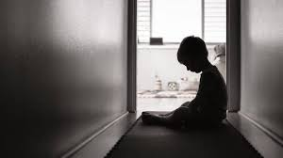
Signs & Indicators of Domestic Abuse in Children
Signs & indicators of a child experiencing domestic abuse at home:
Withdrawn or detached behaviour
Ambivalent feelings towards both the abuser and the non-abusing parent
Constant or frequent sickness
Frustration or aggression
Bullying peers
Problems in school or with learning
Anxiety, depression, self-harm or suicidal thoughts
Drug or alcohol use
Easily startled or seem on edge
Fear of leaving the home
Bed-wetting or increased soiling
Nightmares or insomnia
Withdrawal or struggles with separation
Difficulty identifying feelings or communicating needs
Difficulty developing positive peer relationships
What to do if a child reveals abuse:
Provide a safe space for the young person to share
Let them know they’ve done the right thing telling you
Tell them it’s not their fault
Listen to them and understand their needs
Do not push the child for answers, allow them to share as much as they are comfortable with
Do not confront the alleged abuser
Explain what you will do next
Follow your organisations safeguarding policy and report immediately to a designated safeguarding lead
Notes:
It can be difficult to tell if domestic abuse is happening and those carrying out the abuse can act very different when other people are around. Children and young people might also feel frightened and confused, keeping the abuse to themselves, so if they do disclose the abuse, it is important to follow the advice above and be mindful that other types of abuse may also be happening as well as the domestic abuse.

Slide 9
Barriers to Disclosing Domestic Abuse
For Victims:
There are many reasons why someone being abused will be unwilling or unable to disclose. Usually, it is because of fears that the disclosure will worsen the current situation or be fatal. They may:
Not define their experience as domestic abuse
Experience language barriers
Fear their children will be taken into care
Fear the abusive partner will find them
Fear death
Believe their partner’s promise it won’t happen again
Feel shame & embarrassment and believe it’s their fault
Fear they will not be believed
Fear they will be isolated from their community
Fear they will be deported
Be scared of the future
Have had previous poor experience when they’ve disclosed
For Children:
Children who have experienced domestic abuse often find it difficult and may go to great lengths to hide it because:
They are protective of their abusive and/or non-abusive parent
They are fearful of consequences
They are being threatened by the abusive parent
They are fearful of being taken away from their family
They are fearful of moving schools and loosing friends
They are fearful of exposing their family to dishonour, shame, or embarrassment
Fearful they or family members may be deported
Limited opportunity to disclose / communication ability
Unable to recognise DA
Notes:
Disclosure marks an important step in the help-seeking process but there is a long journey before it and a long one after. Escaping abuse is not a linear process and people go through various stages of preparedness. Disclosure can occur in an informal (that is, with family, colleagues or friends) or a formal (such as police, health, social services, school) context.
Many survivors tell of negative experiences at the point of disclosure where they were judged as responsible for the abuse or alienated for staying in or returning to the relationship
It is essential that professionals recognise barriers for people seeking help from domestic abuse and how this can also be more complex depending on someones protected characteristics: age, disability, gender reassignment, marriage or civil partnership, pregnancy or maternity, race, religion or belief, sex, sexual orientation.

Slide 10
Cultural Competency – Additional Barriers
Domestic abuse can be experienced by anyone regardless of their age, class, culture, disability, lifestyle, race or sexuality.
Minority Ethnic Groups
Experiences of institutional racism & unwilling to engage with service providers
The impact of different cultural values that place additional pressure to remain in the home
Impact of immigration law / fear of deportation
Fear of further persecution from family or community members
Language barriers
Disability
Issues accessing services
Issues arising from partner who is also their carer
LGBTQ+
Discrimination
Older Survivors
Longevity of abuse
Fear of not being believed due to the assumption that older people will be free from abuse
Notes:
Cultural competence is crucial for several reasons:
- Awareness of cultural factors (understanding how these factors can influence experience of survivors & perpetrators. It acknowledges that cultural beliefs, norms, and practices can shape attitudes towards gender roles, power dynamics, and acceptable behaviours)
- Effective communication (By understanding cultural nuances, language barriers, and non-verbal communication styles, professionals can ensure that survivors feel understood, validated, and supported. This facilitates trust-building and empowers survivors to seek help and disclose their experiences.)
- Avoiding re-traumatisation (Cultural competence helps service providers avoid re-traumatisation by being sensitive to survivors’ cultural values, norms, and beliefs. This includes avoiding judgmental attitudes, understanding help-seeking behaviors within cultural contexts, and tailoring interventions to align with survivors’ cultural needs.)
- Tailored intervention (Cultural competence allows for the development and implementation of interventions and prevention strategies that are relevant and effective for specific cultural communities. It recognises that a one-size-fits-all approach may not be suitable and that interventions should be adapted to address cultural barriers, promote community engagement, and respect diverse perspectives)

Slide 11
Leaving an abusive relationship is often the most dangerous time for a victim survivor
MYTH: “If it was that bad, they would leave”. There are many reasons it is hard for a survivor to leave, ranging from practical to emotional, which is often part of the abuse:
Economic dependence
The abuser may control the finances or be the sole source of finances for the family, they may have also destroyed the survivor’s credit / any savings and they may have forced joint accounts or joint benefit claims.
Staying because of the children
Survivors often fear for their children’s safety because the abuser has threatened to hurt them if they leave. They may also have custody concerns if the abuser gains custody or be fearful of uprooting their children. They may also be fearful of losing contact with step-children.
Fear of reprisals
Survivors have often experienced multiple threats and will be fearful of retaliation, of being killed, of the abuser hurting loved ones, of being stalked, or not being believed. Physical harm may have already occurred if the survivor has attempted to leave before.
Lack of knowledge and access to help
The survivor may not be aware of organisations that can help, or have the resources to access these (transportation, telephone, internet, etc.) There may also be problems to access such as language barriers or disability.
Social isolation
Abusers often isolate survivors from friends, family, community support, and resources which often includes monitoring of a survivor’s movements, texts, emails, social media, phone calls and spending. The survivor may feel shame and unable to disclose the abuse.
Accommodation
The survivor may need to leave their home for safety and have no access to alternative accommodation. They may have to make the decision to move to another area for safety, away from their support network & needing to start everything over.
Deportation
Survivors may fear deportation without their partner’s support.
Notes:
Leaving an abuser can be the most dangerous time, a report by Women’s Aid found 55% of women killed by an ex-partner were killed within the first month of separation, 87% in the first year; survivors may leave and return several times as they manage the risk and threats being made by the abuser that can sometimes make it impossible to leave. We need to stop blaming survivors for staying and start supporting them by understanding many of the barriers they face.

Slide 12
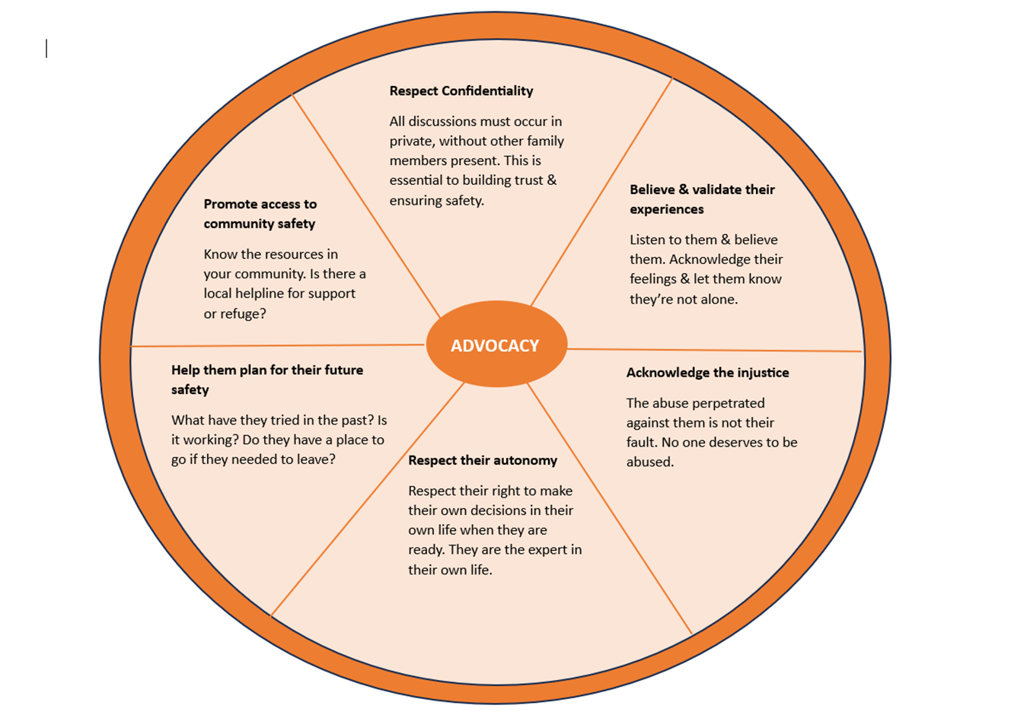
How to respond if an adult victim discloses domestic abuse
Adapted from “The Advocacy Wheel” developed by the Domestic Violence Project
Notes:
It's important to avoid telling people what to do when someone discloses domestic abuse, they need to explore their options preferably with specialist support in Solihull Birmingham & Solihull Women’s Aid are commissioned to provide this support

Slide 13
Domestic Abuse Pathway
You receive a disclosure of domestic abuse
Complete a DASH risk assessment
High-risk
Are you concerned there is immediate risk to life, limb or property of either the individual disclosing, other vulnerable parties (such as children) or the wider community (e.g. from a firearm? ) Contact the police 999
Refer to MARAC
Are there children involved?
Is the individual an adult with care & support needs?
Signpost to specialist domestic abuse services:
Birmingham & Solihull Women’s Aid
Yes
Consult the Right Help, Right Time, Right Response threshold guidance and DVRIM
Do you have concerns about child protection?
Yes
Yes
Seek advice from Adult Social Care One Front Door
Yes
Remember:
Protection
Safeguarding
Specialist Support
Complete a Children’s Social Care MASH Referral
Notes:
People who disclose domestic abuse may need a wide variety of support for example, they may not have access to finances and will need help to know what options they have, they may need to know what housing is available to them, depending on their circumstance every adult or child will have very different needs, the most experienced people to help someone navigate this will be specialist support services provided in Solihull by Birmingham & Solihull Women’s Aid. For those with Children there needs to be consideration to any possibility of significant harm to them, the threshold guidance & DVRIM can help, both available on the SSCP website in the practitioner's toolbox https://www.safeguardingsolihull.org.uk/lscp/multi-agency-procedures-and-practice-guidance/practitioners-tool-box/ or seek advice from children services, for adults one front door will be able to provide advice- contact details on next slide

Slide 14
Seeking support for Safeguarding
Solihull Children’s Services
Children and young people are the most vulnerable members of society. Protecting them from becoming the victims of abuse is everyone's responsibility.
To report a child or young person at risk call 0121 788 4300 (Monday to Thursday 8.45am - 5.00pm, Friday 8.45am - 4.30pm).
Solihull Adult Services
To report abuse of an adult call 0121 704 8007 (Monday to Thursday 8.45am - 5.00pm, Friday 8.45am - 4.30pm)
Emergency Duty Team- out of hours for children & adults
If you are calling out of working hours (Evenings, weekends or bank holidays) please call 0121 605 6060.
In an emergency always call 999.
If you work with children or young people and have concerns, you can complete a referral form:
https://www.safeguardingsolihull.org.uk/

Slide 15
Services for signposting and professional support
A list of local and national support and services can be found here:
Directory of domestic abuse victim support
https://www.solihull.gov.uk/crime-and-safety/domestic-abuse-directory
Notes:
https://www.solihull.gov.uk/crime-and-safety/domestic-abuse-directory

Slide 16

Feedback
We ask that all attendees please complete the following survey to provide feedback on the content of the training. The link can also be found on the attendee resource slides.
https://forms.office.com/Pages/ResponsePage.aspx?id=rgObbdmfb06EmZuschoIFI3p_bzBLXNFh4OYW2Zvh_1URjVINkNTUFBLR1U2WENFMTEyUU4yVFhIQS4u

