Slide 1

Domestic Abuse
Information & Resources

Slide 2
Definition
Behaviour of a person(A) towards another person(B) is “domestic abuse” if:
A and B are each aged 16 or over and are “personally connected” to each other
the behaviour is abusive
Behaviour is “abusive” if it consists of any of the following:
physical or sexual abuse
violent or threatening behaviour
controlling or coercive behaviour
economic abuse
psychological, emotional, or other abuse
And it does not matter whether the behaviour consists of a single incident or a course of conduct.
Definition of “personally connected”:
Two people are “personally connected” to each other if any of the following applies:
- they are, or have been, married
- they are, or have been, civil partners
- they have agreed to marry one another
- they have entered into a civil partnership agreement
- they are, or have been, in an intimate personal relationship with each other
- they each have, or there has been a time when they each have had, a parental relationship in relation to the same child
- they are relatives

Slide 3
Types of Domestic Abuse
Physical Abuse
Violence or intentional and unwanted contact.
- Scratching, punching, biting, strangling, or kicking
- Throwing something at you
- Pulling your hair
- Pushing or pulling you
- Grabbing your clothing
- Grabbing you to prevent you from leaving or forcing you to go somewhere
Emotional Abuse
Threats, insults, humiliation, intimidation, isolation, or stalking.
- Calling you names and putting you down
- Yelling and screaming at you
- Intentionally embarrassing you in public
- Preventing you from seeing or talking with friends or family
- Telling you what to do and wear
- Damaging your property
- Blaming your actions for their abusive behaviour
- Threatening to commit suicide to prevent you from breaking up with them
- Threatening to harm you, your pet, or people you care about
- Making you feel guilty or immature when you don’t consent to sexual activity
- Threatening to have your children taken away
Financial Abuse
Can be very subtle – telling you what you can and cannot buy or requiring you to share control of your bank accounts
- Giving you an allowance and closely watching what you buy
- Placing your wages in their account and denying you access to it
- Keeping you from seeing shared bank accounts
- Forbidding you to work or limiting the hours you do
- Preventing you from going to work
- Getting you fired by harassing you, your employer, or coworkers on the job
- Maxing out your credit cards without permission
- Refusing to give you money for food, rent, medicine, or clothing
- Spending money on themselves but not allowing you to do the same
Psychological Abuse
A person subjecting another person to behaviour which may result in psychological trauma including anxiety or PTSD.
- Gaslighting
- Moving things around the house, then denying it
- Denying that they or you said things
- Telling you people have said things about you
- Telling you have a mental health condition when you don’t
- Making derogatory jokes about you to others in front of you
- Name calling
- Questioning you endlessly about everything you do or say
Coercive Control
A pattern of intimidation, degradation, isolation and control with the use or threat of physical and sexual violence
- Unreasonable demands
- Degradation
- Restricting daily activities
- Threats or intimidation
- Financial control
- Monitoring of time
- Taking your phone away
- Deprivation of food
- Destruction of possessions
Sexual Abuse
Any action that pressures you to do something sexually you don’t want to do.
- Unwanted kissing or touching
- Unwanted rough or violent sexual activity
- Rape or attempted rape
- Refusing to use condoms or restricting access to birth control
- Threatening you into unwanted sexual activity
- Pressuring or forcing you to have sex or perform sexual acts
- Using sexual insults towards you
Digital Abuse
The use of technologies (such as texting and social networking) to bully, harass, stalk or intimidate.
- Tells you who you can or cannot be social media “friends” with
- Send you negative, insulting, or threatening emails or online messages
- Posts negative things about you
- Monitors your social media sites
Notes:
Domestic abuse is not just physical violence, in fact sometimes it does not always include physical violence.
Resources
Power and Control Wheel | The National Domestic Violence Hotline (thehotline.org)

Slide 4

Types of Domestic Abuse
Teenage Relationship Abuse
If the victim and perpetrator are at least 16 years old, abuse in the relationship can fall under the statutory definition of domestic abuse. Whilst young people under 16 can experience abuse in a relationship, it would be considered child abuse as a matter of law.
Harassment or Stalking
Stalking is a pattern of fixated and obsessive behaviour which is repeated, persistent, intrusive, and causes fear of violence or engenders alarm and distress in the victim.
Harassment covers “causing alarm or distress” and the more serious offence of “putting people in fear of violence”.
So-called “Honor” Based Abuse
So-called honour-based abuse can take a variety of forms, including female genital mutilation (FGM), forced marriage, honour killings, abandonment, breast flattening and other forms of domestic abuse perpetrated in a perceived defence of “honour”. It is the motivating factors behind the abuse that identifies it as honour-based, rather than the abuse itself, and that it is usually carried out with the collusion or approval from family and/or community members.
Abuse by Family Members
Domestic abuse may be perpetrated by a family member: by children, grandchildren, parents, those with “parental responsibility”, siblings, or extended families including in-laws.
Religious Abuse
When a victim is prevented from carrying out their religious or spiritual practices or are forced to engage in activities that are in conflict with their beliefs.
Forced Marriage
When you face physical pressure to marry (e.g. threats, physical violence, or sexual violence) or emotional and psychological pressure (e.g. if you’re made to feel like you’re bringing shame to the family
Child to Parent Abuse
Abuse within the family includes child-to-parent abuse, also commonly referred to as Adolescent to Parent Violence/Abuse (CAPVA). Child-to-parent abuse can involve children of all ages, including adult children, and abuse towards siblings, grandparents, aunts, uncles, as well as other family members, such as those acting as kinship carers.
Verbal Abuse
May amount to emotional or psychological abuse, threatening behaviour, or controlling or coercive behaviour. Some examples include: repeated yelling and shouting, threatening or degrading language, verbal humiliation in private or public, being laughed at and being made fun of, name-calling, etc.
Female Genital Mutilation
Comprises all procedures that involve partial or total removal of external female genitalia, or other injury to the female genital organs for non-medical reasons.

Slide 5
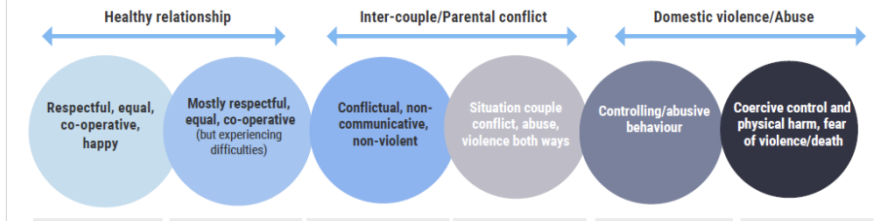
Professional Curiosity & Understanding Dynamics
Professional curiosity is the capacity and communication skill to explore and understand what is happening within a family rather than making assumptions or accepting things at face value.
It is important to explore and understand relational dynamics to differentiate parental conflict from high harm domestic abuse, where there is a clearer “victim” and “abuser”. This can sometimes be unclear due to disclosures from both parents, in this case it is also important to explore dynamics.
Questions to support exploring dynamics further can be found here: Parental_conflict_with_spectrum-updated-Feb-2023.pdf (safeguardingsolihull.org.uk)
The continuum above is designed to help people explore the dynamics of a relationship; constructive conflict is a natural part of any relationship & would exist in respectful, equal & co-operative happy relationships.
Frequent, intense and poorly resolved disagreements can be a sign of difficulties emerging, and has a negative impact on all involved, including children.
Care needs to be taken to thoroughly explore any possibility of control within a relationship, as this raises concerns of risk and harm. Coercive control can still exist where physical abuse doesn’t.
Perpetrators may make false accusations that abuse occurs both ways or victims may retaliate to abuse they are experiencing.

Slide 6
Mental Health
Experiencing domestic abuse can impact mental health in a variety of ways, with reported higher levels of depression, anxiety, stress disorders (such as PTSD), eating disorders, low self-esteem, self-harm, and suicidal thoughts or attempts.
Emotional
Living through domestic abuse can make it difficult to function in daily life. Survivors may feel ashamed, see themselves as unworthy, and suffer from a significantly diminished self-perception. They may feel they are constantly “walking on eggshells” and have limited “space for action” – that is that they do not have the freedom to do or say things to meet their own needs without worry or fear, or the needs of children or pets.
Physical Health
In the short term, survivors may experience injuries such as bruising, lacerations, burns, cuts and broken bones. More serious injuries may lead to disabilities.
Social
Victims may be isolated from family and friends through both coercive control, and by choice. Victims may also be isolated from the community or work for the same reasons.
Financial
Leaving an abusive relationship can have financial implications, such as costs for housing, transportation, and legal proceedings. Financial abuse can also lead to poverty for victims. Victims may also lose their job due to absences or being forced to.
Impact of Domestic Abuse to the Survivor

Slide 7
Impact of Domestic Abuse to Children
Constraints on their freedom
Control of their time and movement
Isolation from wider family, peers and activites
Restricted social lives
Reduced opportunity for fun & affection
Damage to parent-child relationships
Neglect
Physical injuries
Lack of trust
Self-blame
Negative emotions – shame, anger, guilt & fear
Section 3 of the Domestic Abuse Act 2021 recognises children as victims of domestic abuse if the child sees, hears, or experiences the effects of the abuse, and is related to, or falls under “parental responsibility” of, the victim and/or perpetrator of the domestic abuse.

Slide 8
Indicators of a child experiencing domestic abuse at home
Withdrawn or detached behaviour
Ambivalent feelings towards both the abuser and the non-abusing parent
Constant or frequent sickness
Frustration or aggression
Bullying peers
Problems in school or with learning
Anxiety, depression, self-harm or suicidal thoughts
Drug or alcohol use
Easily startled or seem on edge
Fear of leaving the home
Bed-wetting or increased soiling
Nightmares or insomnia
Withdrawal or struggles with separation
Difficulty identifying feelings or communicating needs
Difficulty developing positive peer relationships
What to do if a child reveals abuse:
Provide a safe space for the young person to share
Let them know they’ve done the right thing telling you
Tell them it’s not their fault
Listen to them and understand their needs
Do not push the child for answers, allow them to share as much as they are comfortable with
Do not confront the alleged abuser
Explain what you will do next
Follow your organisations safeguarding policy and report immediately to a designated safeguarding lead

Slide 9
Barriers to disclosing domestic abuse
For Survivors:
There are many reasons why someone being abused will be unwilling or unable to disclose. Usually, it is because of fears that the disclosure will worsen the current situation or be fatal. They may:
Not define their experience as domestic abuse
Experience language barriers
Fear their children will be taken into care
Fear the abusive partner will find them
Fear death
Believe their partner’s promise it won’t happen again
Feel shame & embarrassment and believe it’s their fault
Fear they will not be believed
Fear they will be isolated from their community
Fear they will be deported
Be scared of the future
Have had previous poor experience when they’ve disclosed
For Children:
Children who have experienced domestic abuse often find it difficult and may go to great lengths to hide it because:
They are protective of their abusive and/or non-abusive parent
They are fearful of consequences
They are being threatened by the abusive parent
They are fearful of being taken away from their family
They are fearful of moving schools and loosing friends
They are fearful of exposing their family to dishonour, shame, or embarrassment
Fearful they or family members may be deported
Limited opportunity to disclose / communication ability
Unable to recognise DA

Slide 10
Cultural Competency – Additional Barriers
Domestic abuse can be experienced by anyone regardless of their age, class, culture, disability, lifestyle, race or sexuality.
Minority Ethnic Groups
Experiences of institutional racism & unwilling to engage with service providers
The impact of different cultural values that place additional pressure to remain in the home
Impact of immigration law / fear of deportation
Fear of further persecution from family or community members
Language barriers
Disability
Issues accessing services
Issues arising from partner who is also their carer
LGBTQ+
Discrimination
Older Survivors
Longevity of abuse
Fear of not being believed due to the assumption that older people will be free from abuse
Notes:
Cultural competence is crucial for several reasons:
- Awareness of cultural factors (understanding how these factors can influence experience of survivors & perpetrators. It acknowledges that cultural beliefs, norms, and practices can shape attitudes towards gender roles, power dynamics, and acceptable behaviours)
- Effective communication (By understanding cultural nuances, language barriers, and non-verbal communication styles, professionals can ensure that survivors feel understood, validated, and supported. This facilitates trust-building and empowers survivors to seek help and disclose their experiences.)
- Avoiding re-traumatisation (Cultural competence helps service providers avoid re-traumatisation by being sensitive to survivors’ cultural values, norms, and beliefs. This includes avoiding judgmental attitudes, understanding help-seeking behaviors within cultural contexts, and tailoring interventions to align with survivors’ cultural needs.)
- Tailored intervention (Cultural competence allows for the development and implementation of interventions and prevention strategies that are relevant and effective for specific cultural communities. It recognises that a one-size-fits-all approach may not be suitable and that interventions should be adapted to address cultural barriers, promote community engagement, and respect diverse perspectives)

Slide 11
Leaving an abusive relationship is often the most dangerous time for a survivor
MYTH: “If it was that bad, they would leave”. There are many reasons it is hard for a survivor to leave, ranging from practical to emotional, which is often part of the abuse:
Economic dependence
The abuser may control the finances or be the sole source of finances for the family, they may have also destroyed the survivor’s credit / any savings and they may have forced joint accounts or joint benefit claims.
Staying because of the children
Survivors often fear for their children’s safety because the abuser has threatened to hurt them if they leave. They may also have custody concerns if the abuser gains custody or be fearful of uprooting their children. They may also be fearful of losing contact with step-children.
Fear of reprisals
Survivors have often experienced multiple threats and will be fearful of retaliation, of being killed, of the abuser hurting loved ones, of being stalked, or not being believed. Physical harm may have already occurred if the survivor has attempted to leave before.
Lack of knowledge and access to help
The survivor may not be aware of organisations that can help, or have the resources to access these (transportation, telephone, internet, etc.) There may also be problems to access such as language barriers or disability.
Social isolation
Abusers often isolate survivors from friends, family, community support, and resources which often includes monitoring of a survivor’s movements, texts, emails, social media, phone calls and spending. The survivor may feel shame and unable to disclose the abuse.
Accommodation
The survivor may need to leave their home for safety and have no access to alternative accommodation. They may have to make the decision to move to another area for safety, away from their support network & needing to start everything over.
Deportation
Survivors may fear deportation without their partner’s support.

Slide 12
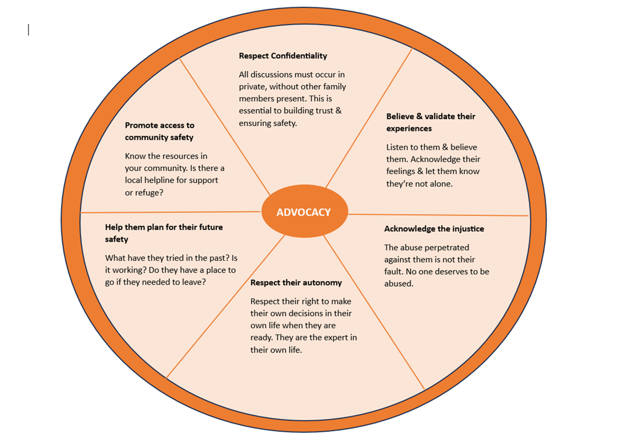
Professional Response to an Adult Victim’s Disclosure of Domestic Abuse
Adapted from “The Advocacy Wheel” developed by the Domestic Violence Project

Slide 13
Domestic Abuse Pathway
Refer to MARAC
High-risk
You receive a disclosure of domestic abuse
Complete a DASH risk assessment
Are you concerned there is immediate risk to life, limb or property of either the individual disclosing, other vulnerable parties (such as children) or the wider community (e.g. from a firearm? ) Contact the police 999
Are there children involved?
Is the individual an adult with care & support needs?
Signpost to specialist domestic abuse services:
Birmingham & Solihull Women’s Aid
Call Solihull Community Outreach on 0121 722 2142 or 0121 643 0821 for male support.
Homepage - Birmingham Solihull Women's Aid (bswaid.org)
Yes
Consult the Right Help, Right Time, Right Response threshold guidance and DVRIM
Do you have concerns about child protection?
Yes
Complete Inter agency referral form for Children Social Care or Engage
To discuss concerns
MASH team 0121 788 4300
Emergency Duty Team 0121 605 6060
Yes
Refer to Adult Social Care on 0121 704 8007 or out of hours on 0121 605 6060

Slide 14
Safeguarding
Solihull Children’s Services
Children and young people are the most vulnerable members of society. Protecting them from becoming the victims of abuse is everyone's responsibility.
To report a child or young person at risk call 0121 788 4300 (Monday to Thursday 8.45am - 5.00pm, Friday 8.45am - 4.30pm).
Solihull Adult Services
To report abuse of an adult call 0121 704 8007 (Monday to Thursday 8.45am - 5.00pm, Friday 8.45am - 4.30pm)
Emergency Duty Team- out of hours for children & adults
If you are calling out of working hours (Evenings, weekends or bank holidays) please call 0121 605 6060.
In an emergency always call 999.
If you work with children or young people and have concerns, you can complete a referral form:
https://www.safeguardingsolihull.org.uk/

Slide 15
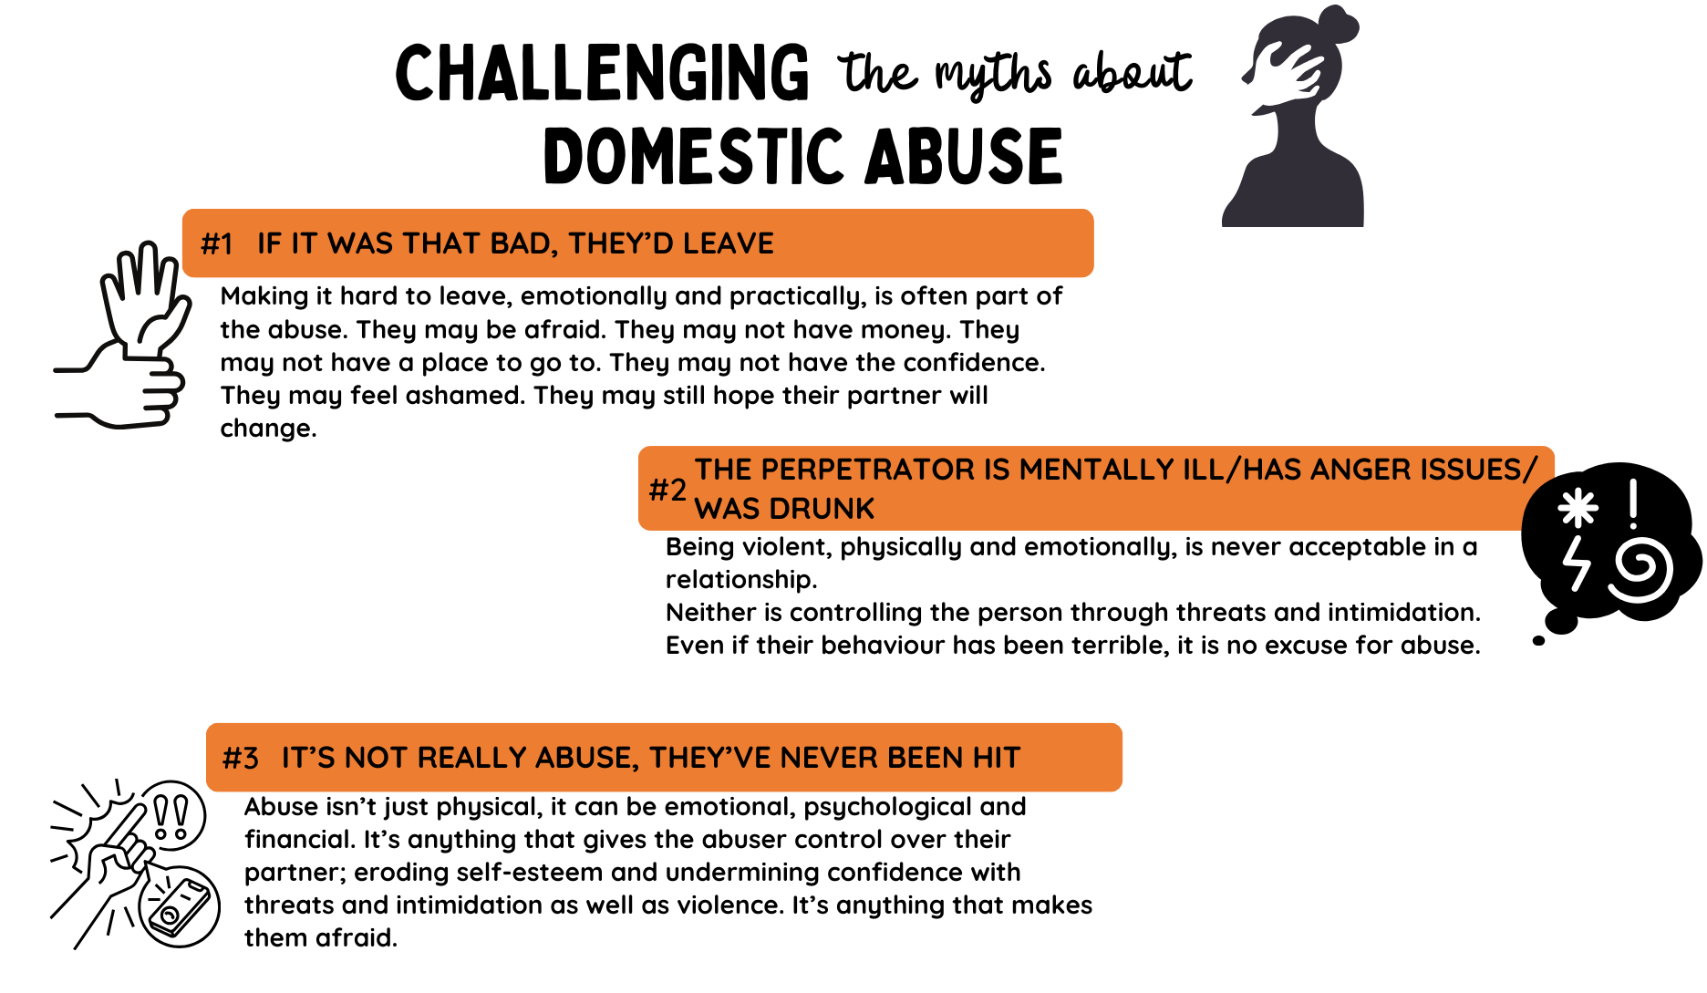

Slide 16
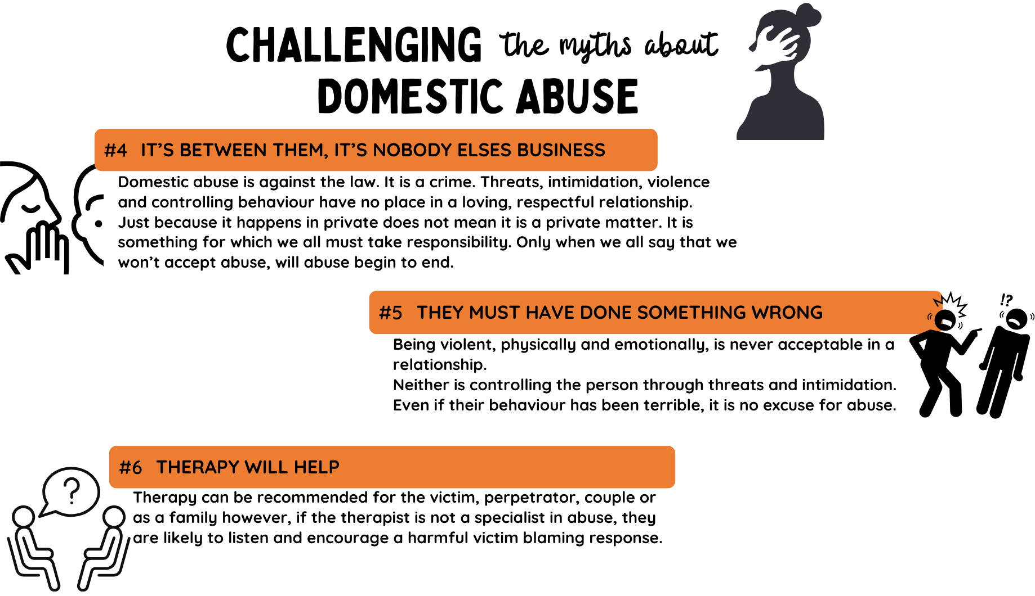

Slide 17
Professional Support
Directory of domestic abuse victim support services
https://www.solihull.gov.uk/crime-and-safety/domestic-abuse-directory
Information for professionals
Information for professionals (solihull.gov.uk)
Solihull Community Housing – Duty to Refer
The Duty to Refer - Solihull Community Housing
Solihull Safeguarding Children Partnership – Sign up to the newsletter!
Home - Solihull Safeguarding Children Partnership (safeguardingsolihull.org.uk)
Solihull Safeguarding Adults Board – Sign up to the newsletter!
Home - Solihull Safeguarding Adults Board (safeguardingsolihull.org.uk)

Slide 18

Feedback
If you have recently received training in your organisation, please complete the following feedback form to support us to develop and improve:
https://forms.office.com/Pages/ResponsePage.aspx?id=rgObbdmfb06EmZuschoIFI3p_bzBLXNFh4OYW2Zvh_1URjVINkNTUFBLR1U2WENFMTEyUU4yVFhIQS4u

